Slide 1
Software Requirements Specification NGO Management System Prepared by Supervised by Md. Abdul Motin Md. Rajaul Islam ID : 1246494 Round : 39 Used Technology Java, Spring, Hibernate, Spring boot, HTML, Spring Security Bootstrap, CSS, IntelliJ IDEA & Mysql

Slide 2
Requirements Mahananda Rural Development program. Here is deposit micro credit account and distributed loan for these un development society expected improve they are life and social situation. We need to build a software for Ngo Management System. The application will have following feature:

Slide 3
Requirement analysis There will be different type users like Admin, super admin, user, etc. There will be account type like daily, monthly saving account and loan account. There will be nominee and one account may have one or more nominees and one nominee may have one or more account. Account opening balance at least 200 tk. An account holder must have a deposit book. An account holder must take a loan above 20,00000 tk. An account holder must see their total amount, total deposit, total loan. An account holder must check their how much money pay of their total amount of loan. An account holder checks their profit and losses. An account holder sees their daily, monthly and Yearly Deposit.

Slide 4
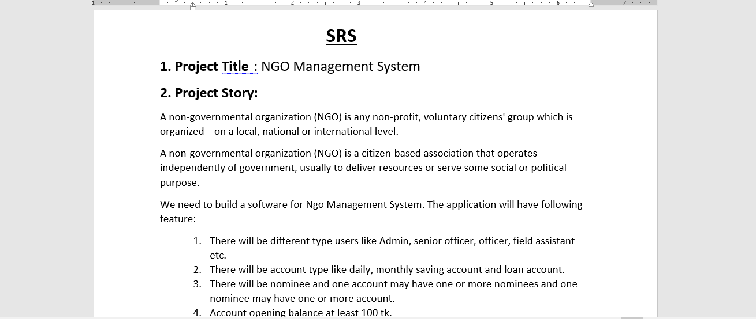
Project Story

Slide 5
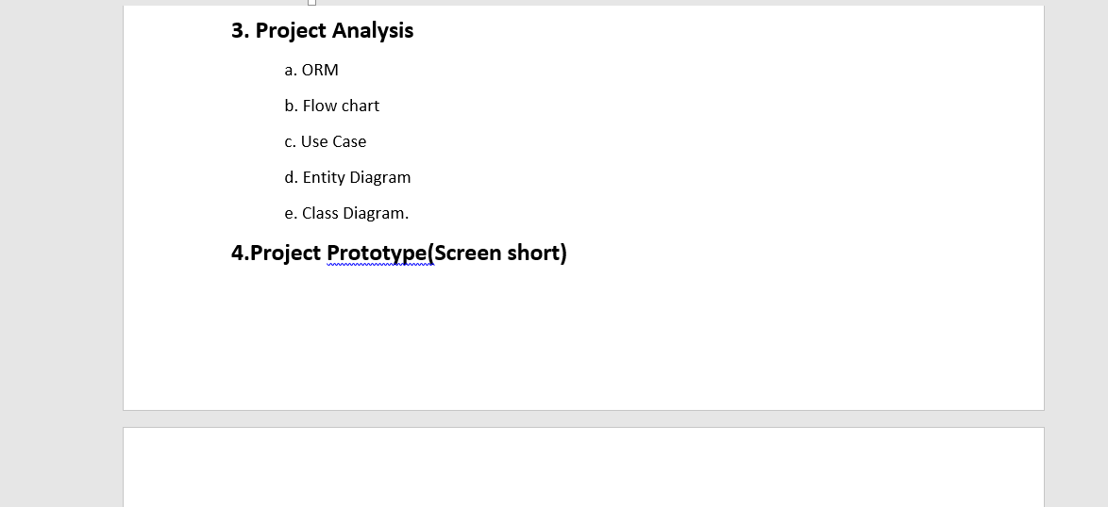

Slide 6
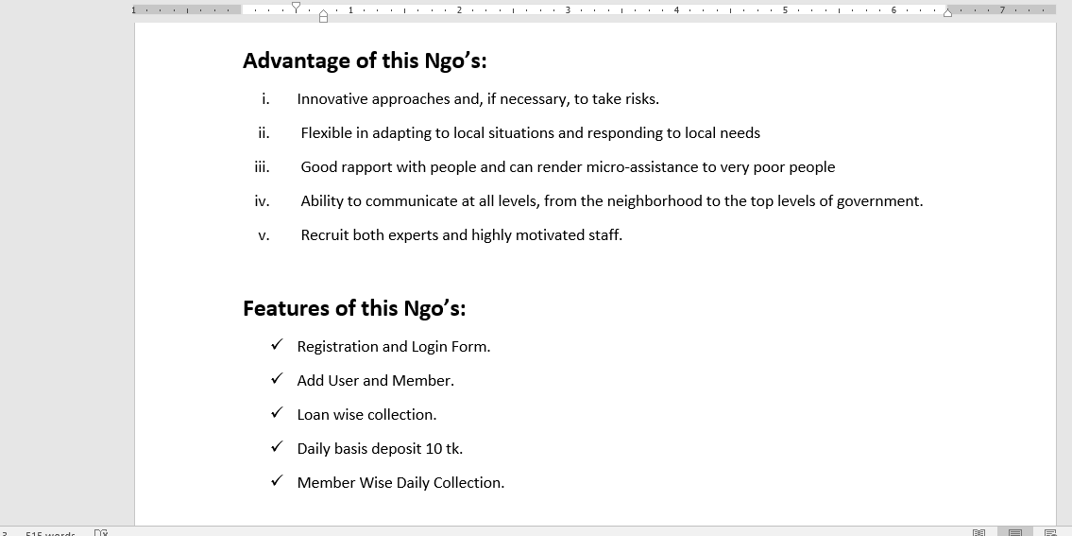

Slide 7
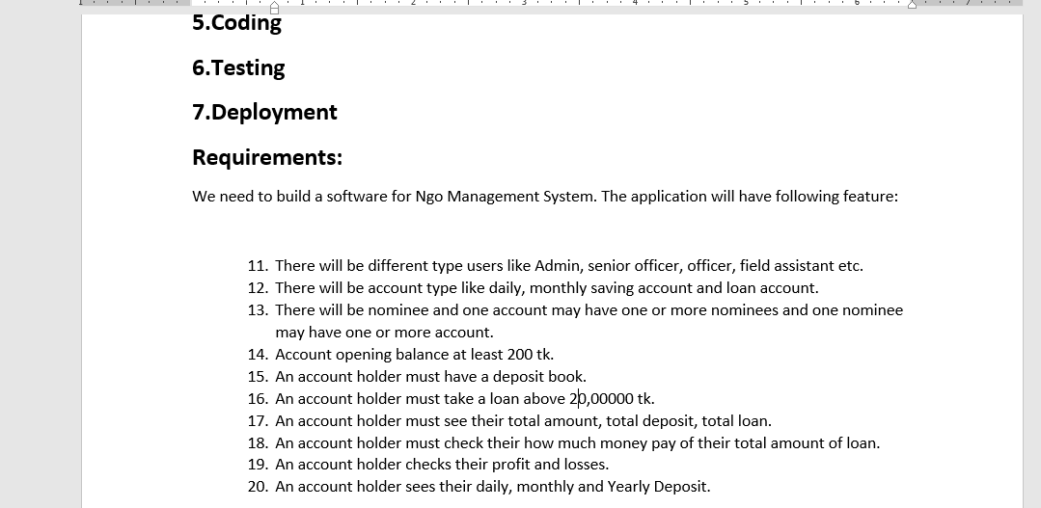

Slide 8
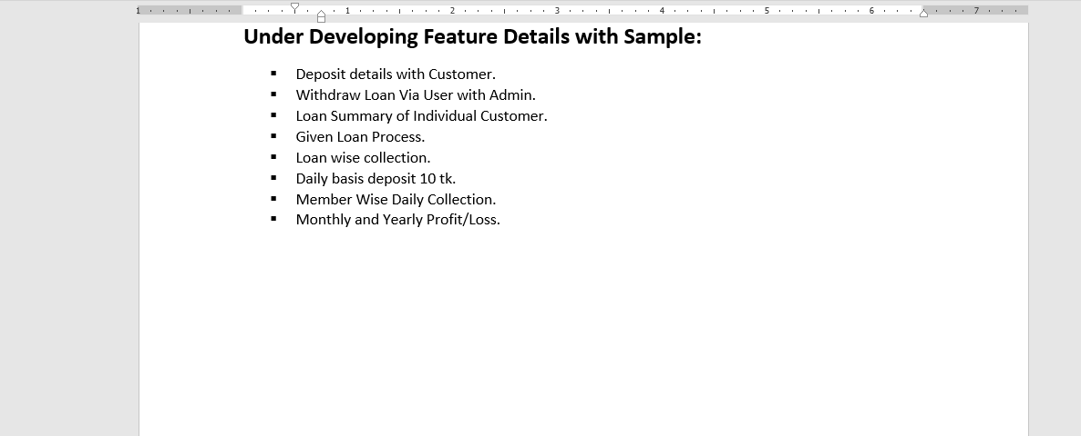
Development Ngo

Slide 9
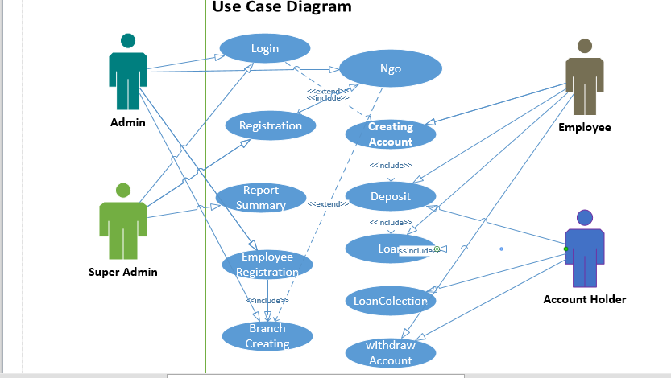
Use Case Diagram

Slide 10
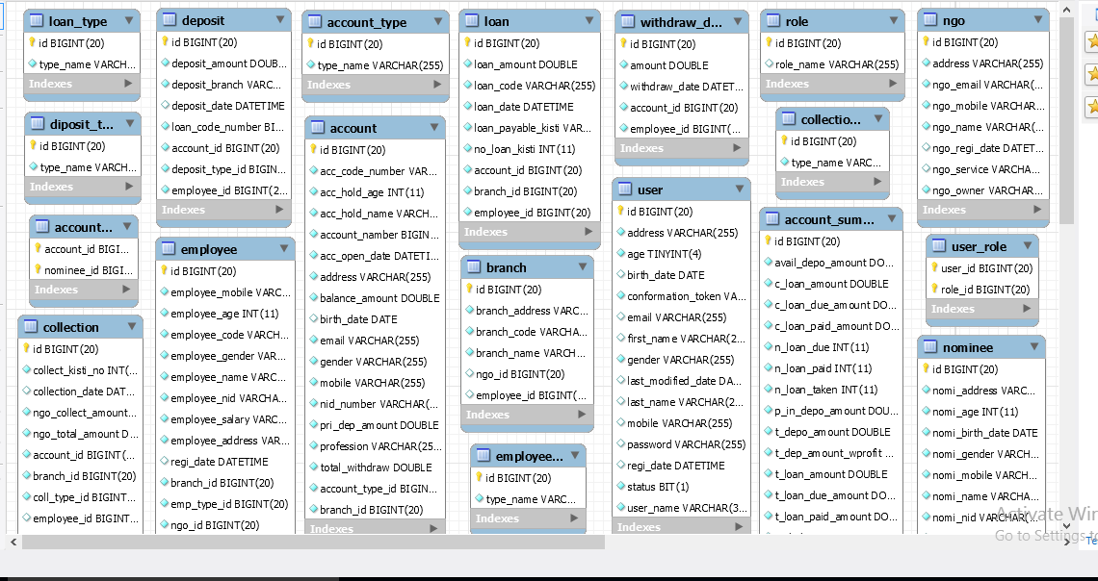
Class Diagram

Slide 11

Login Page

Slide 12
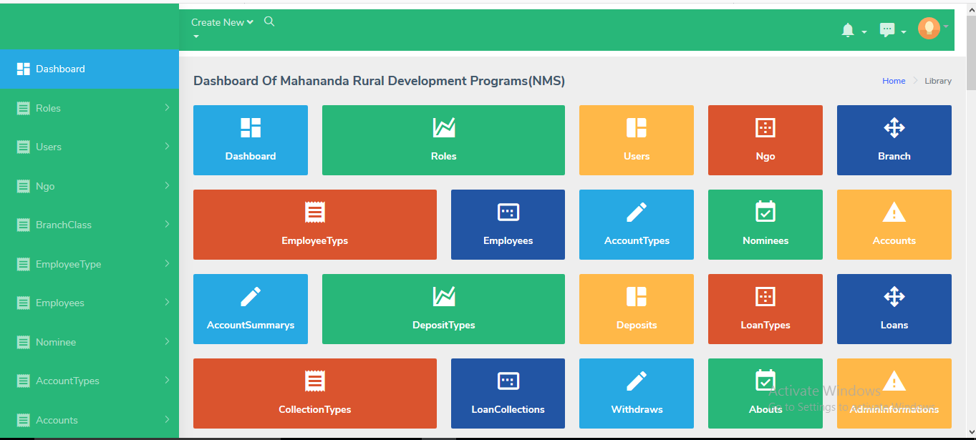
Dashboad

Slide 13
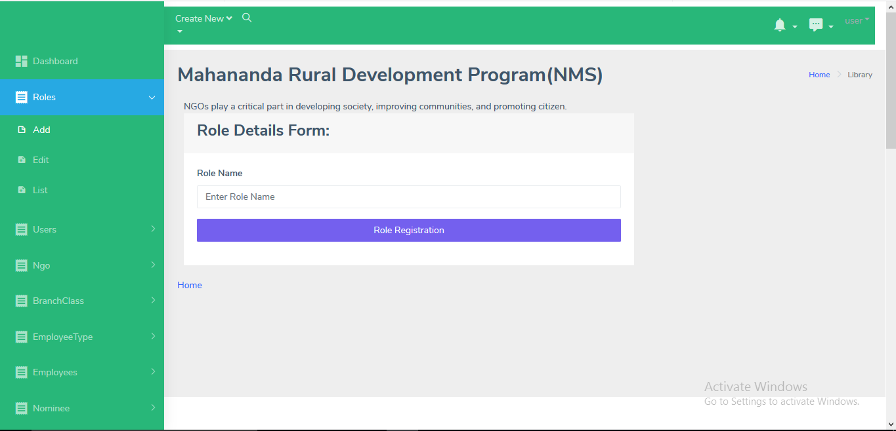
Role Add

Slide 14
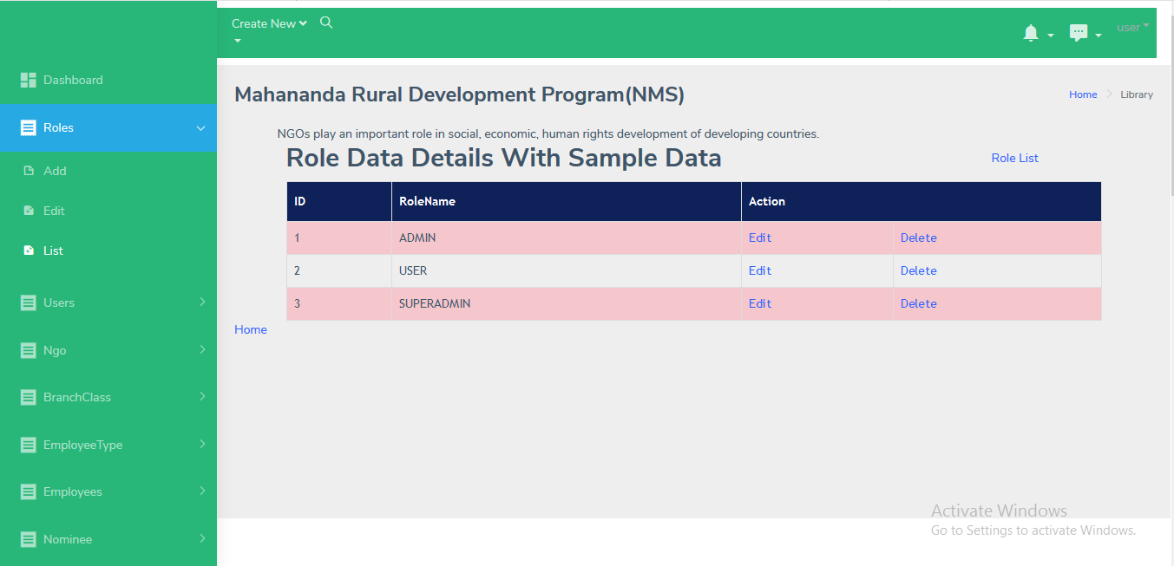
Role List

Slide 15
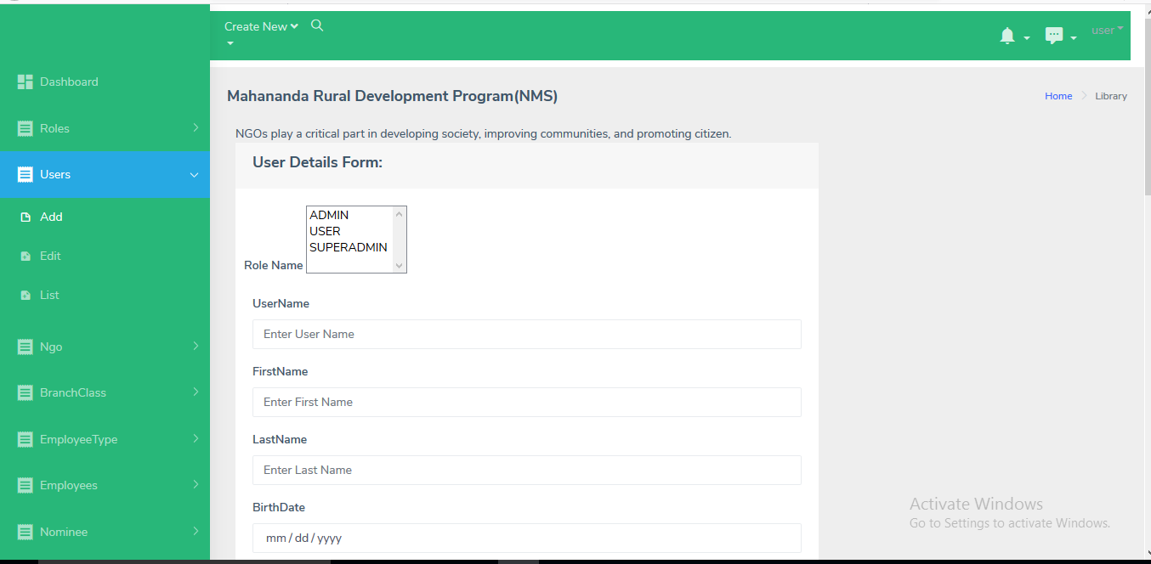
User Add 1

Slide 16
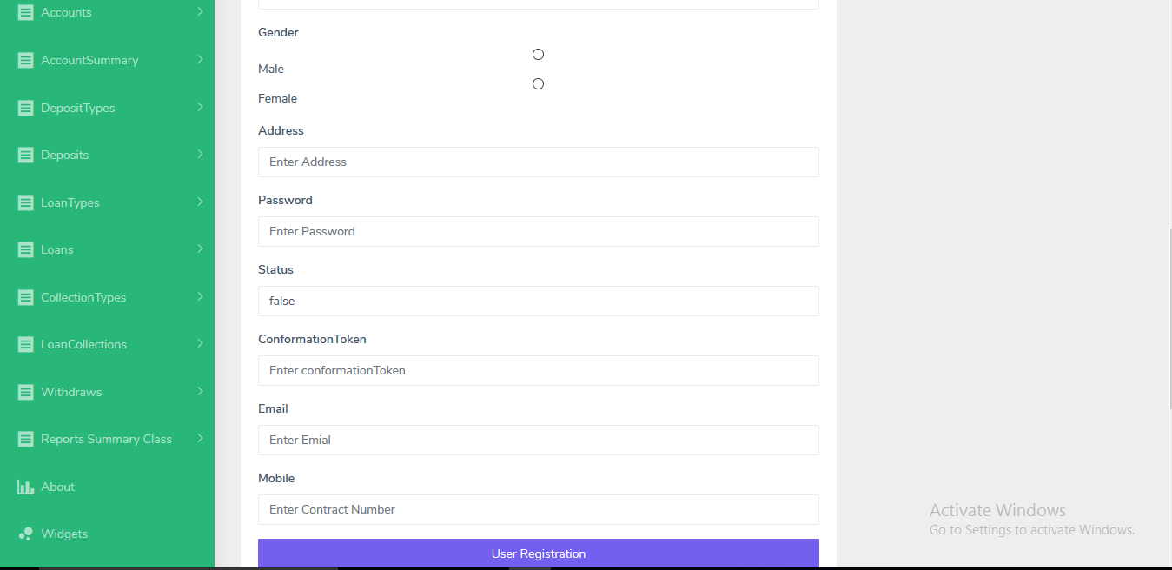
User Add 2

Slide 17
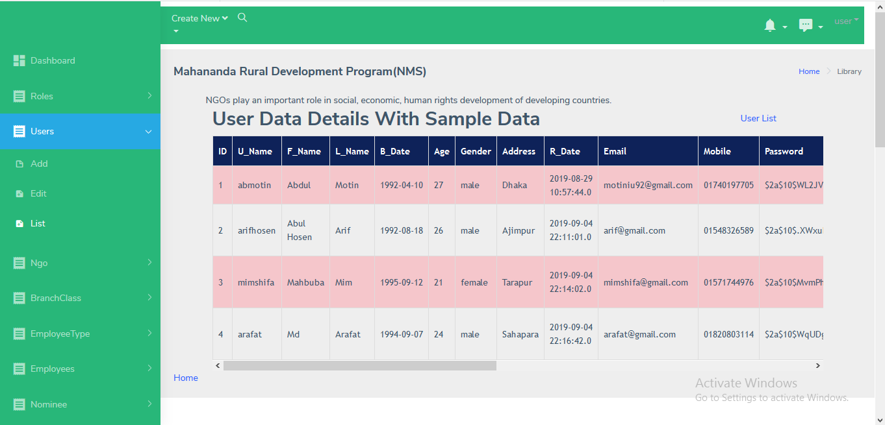
User List

Slide 18
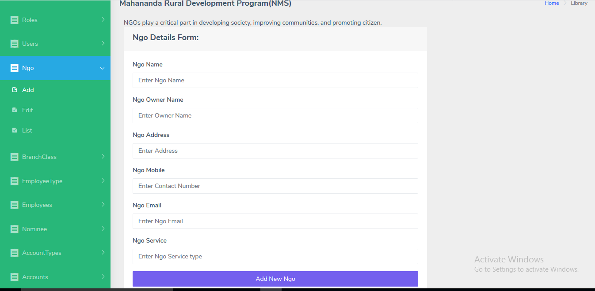
Ngo Add

Slide 19
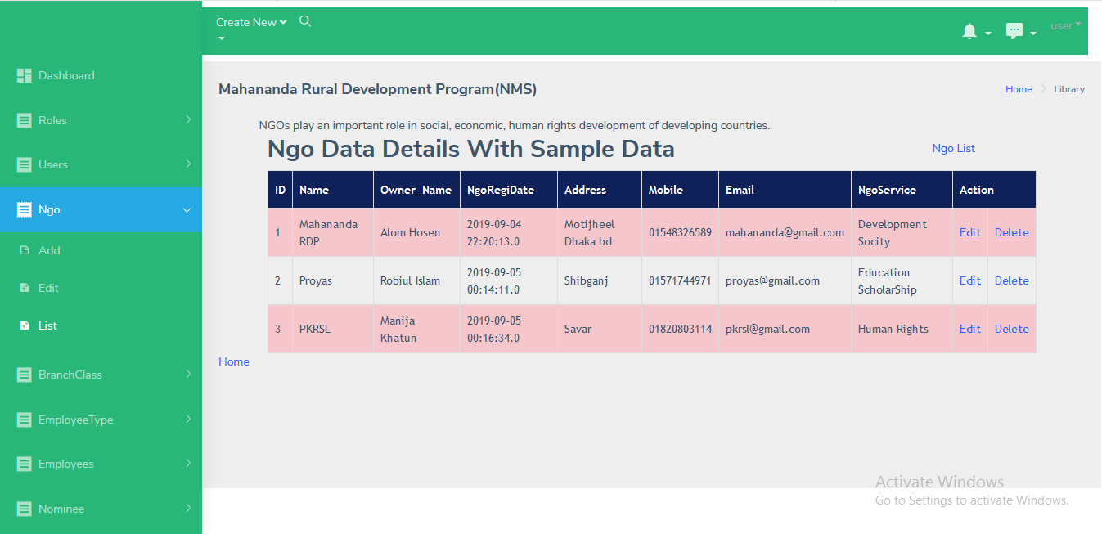
Ngo List

Slide 20
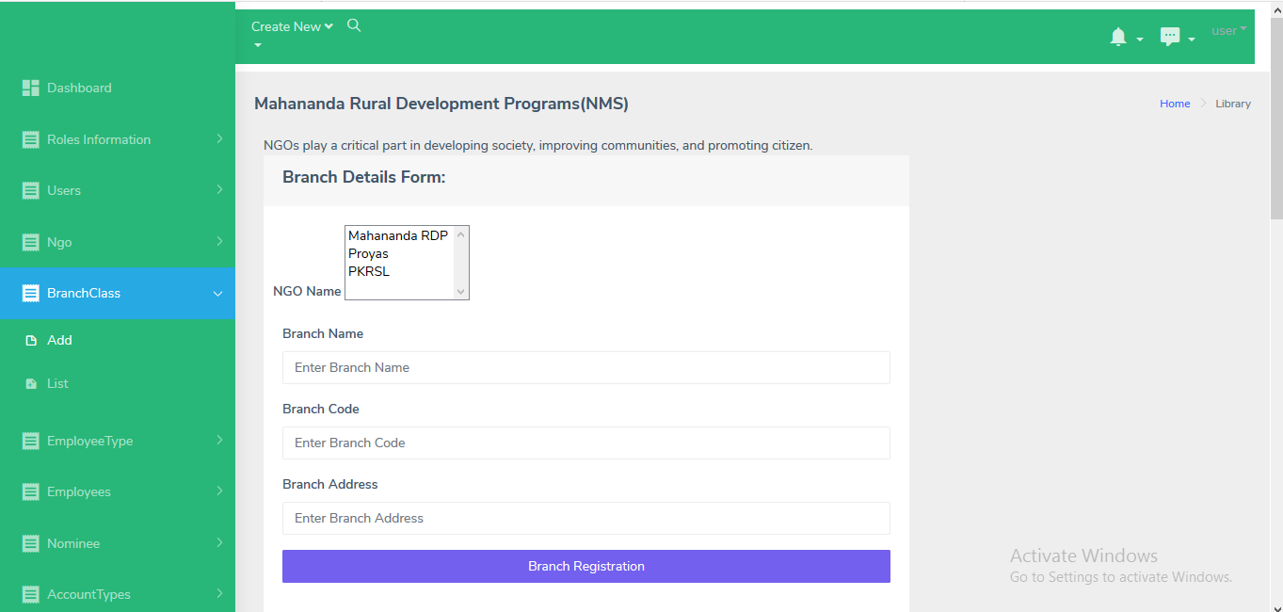
Branch Add

Slide 21
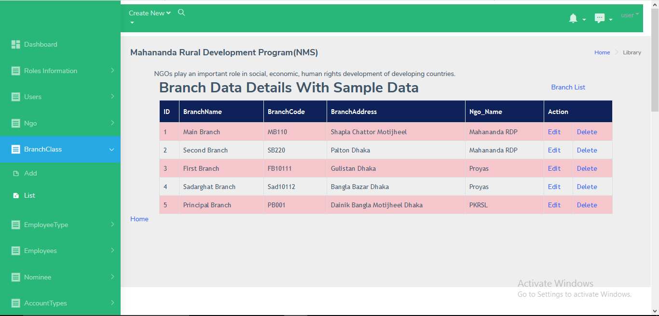
Branch List

Slide 22
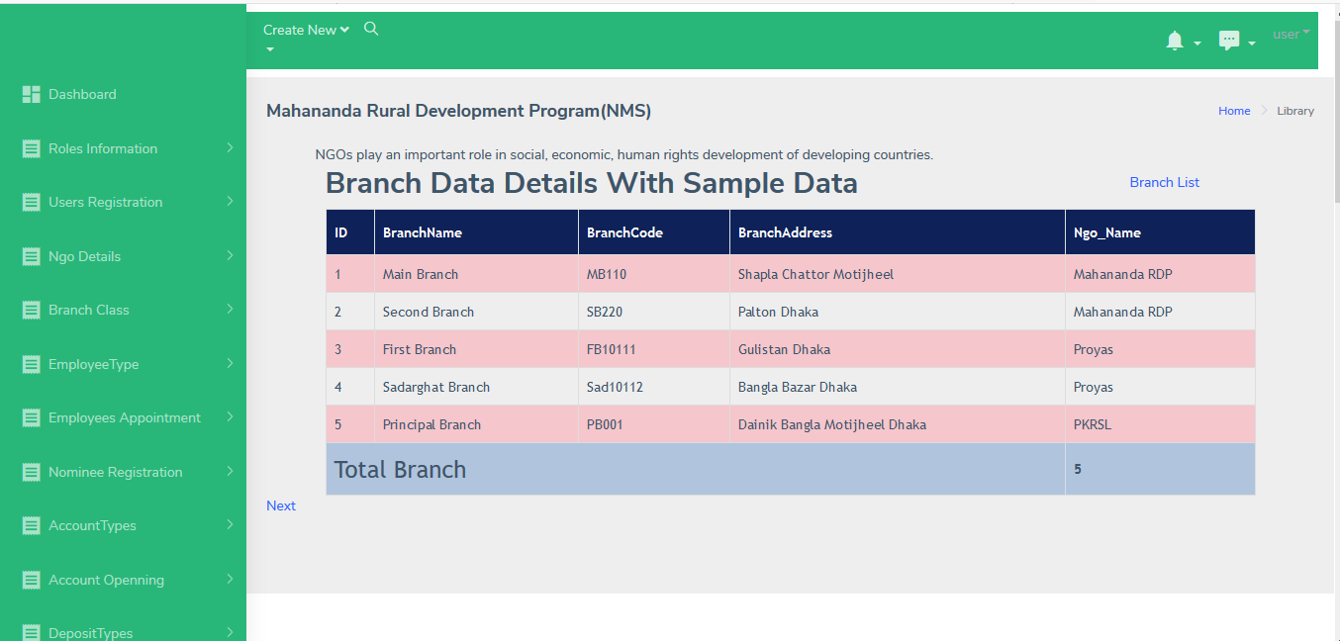
Report Summary Branch

Slide 23
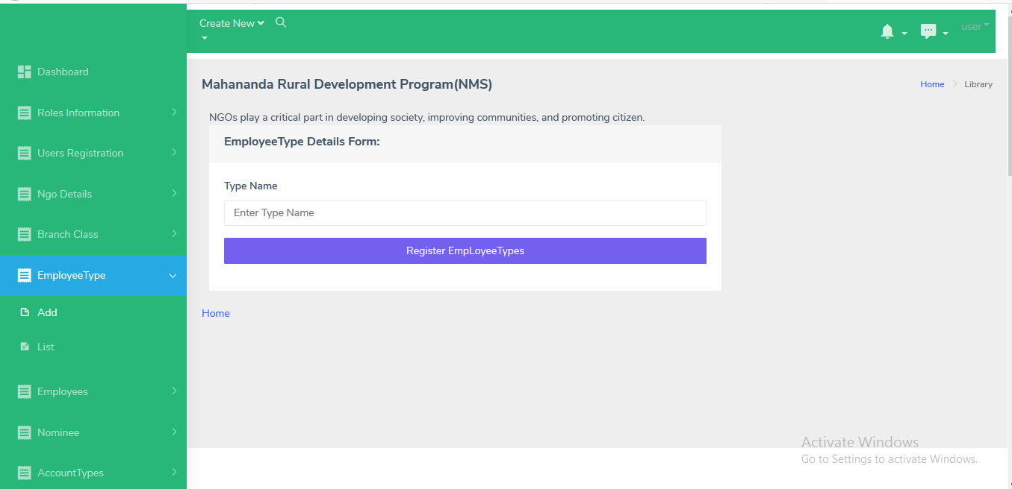
Employee Type Add

Slide 24
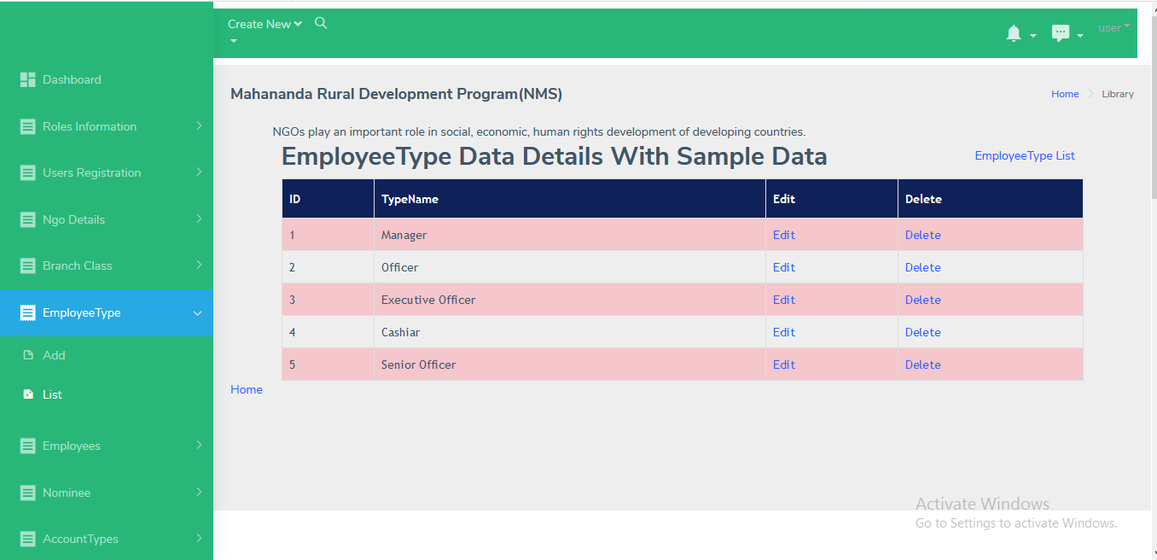
Employee Type List

Slide 25
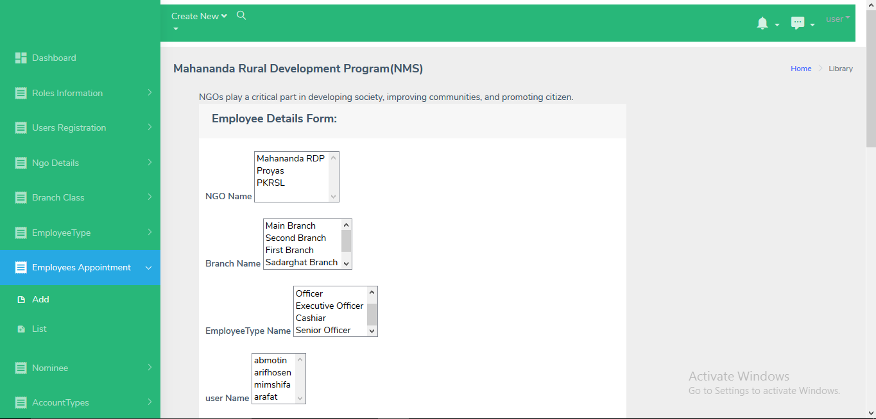
Employee Add 1

Slide 26
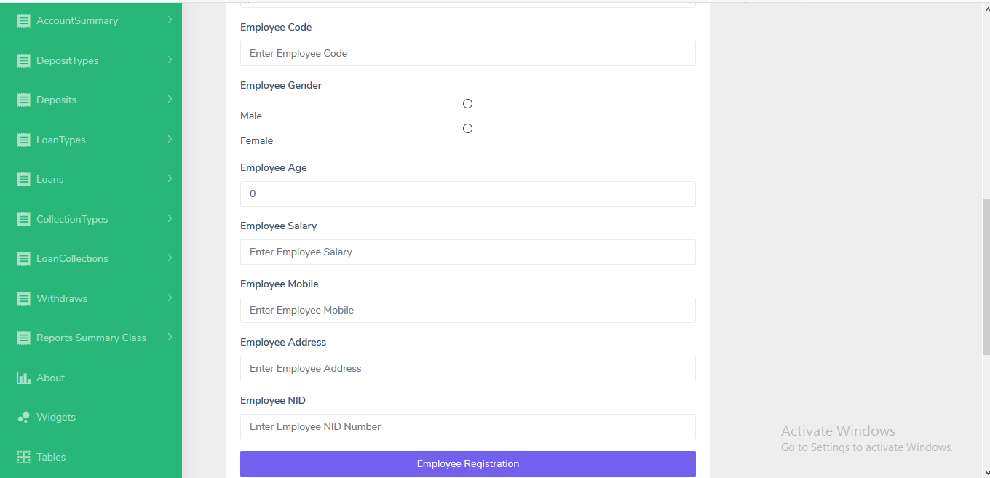
Employee Add2

Slide 27
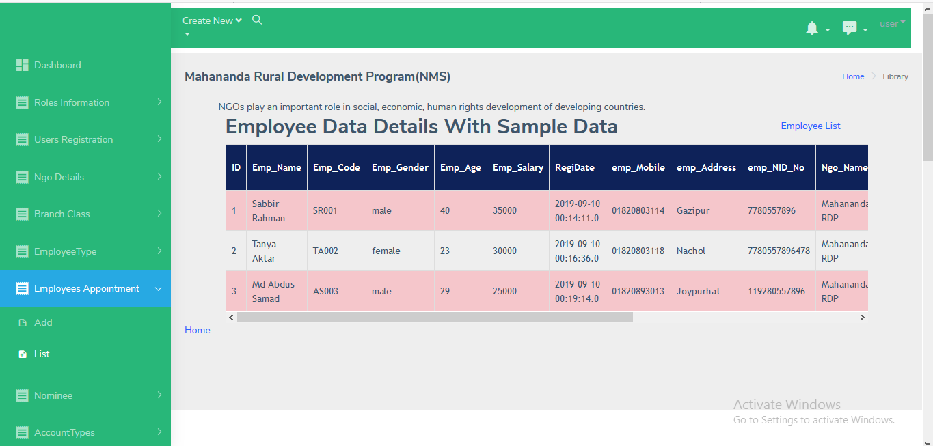
Employee List

Slide 28
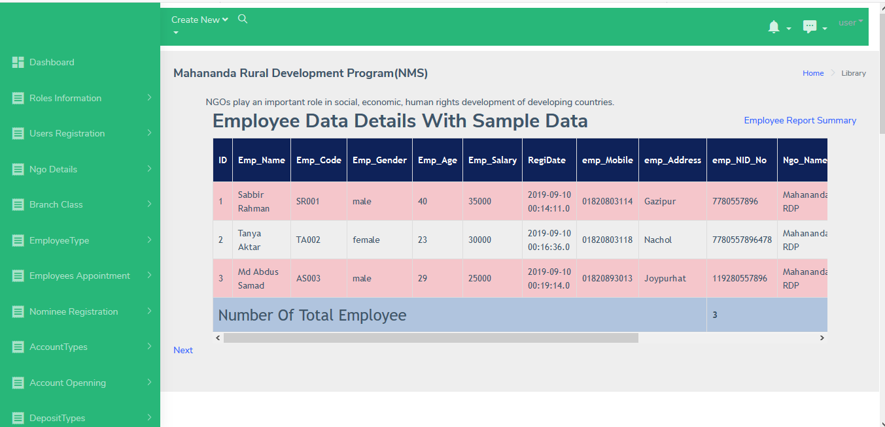
Report Summary Employee

Slide 29
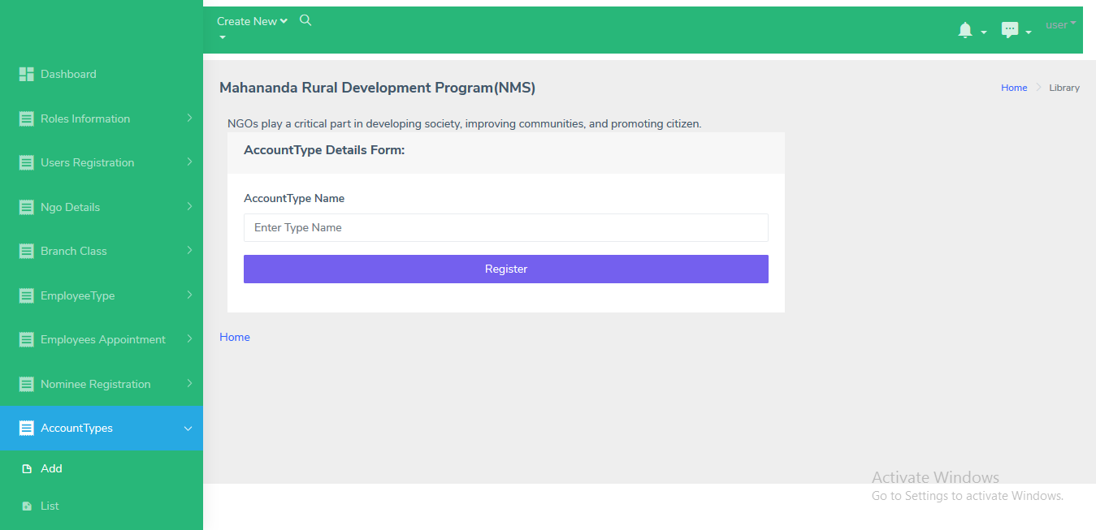
Account Type Add

Slide 30
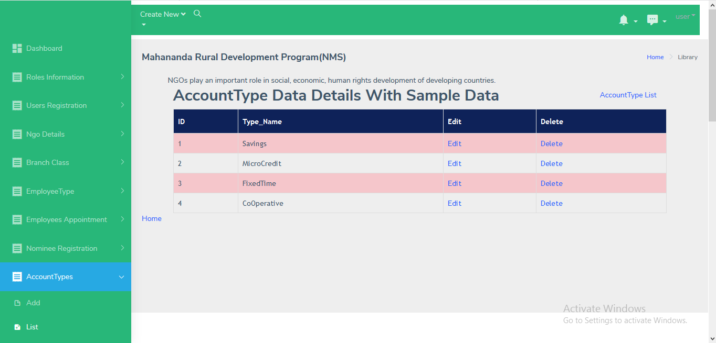
Account Type List

Slide 31
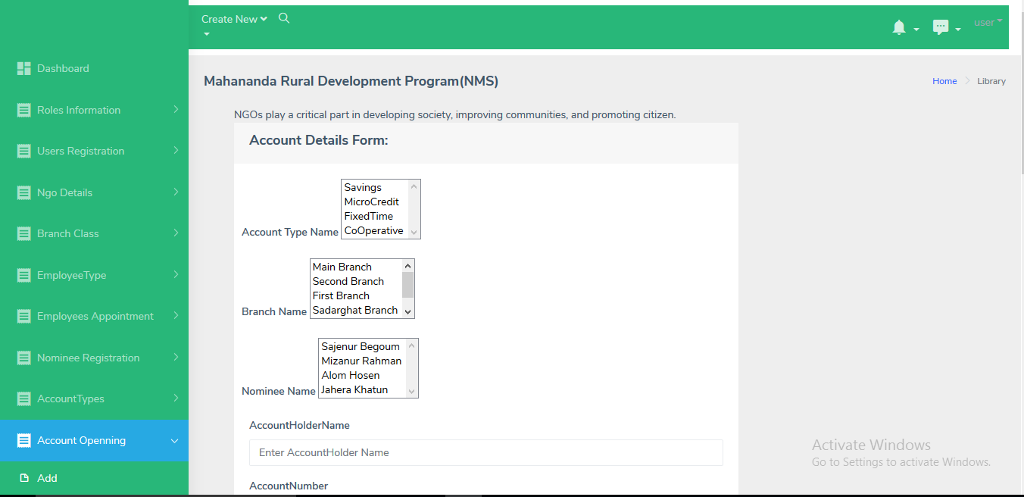
Account Add1

Slide 32
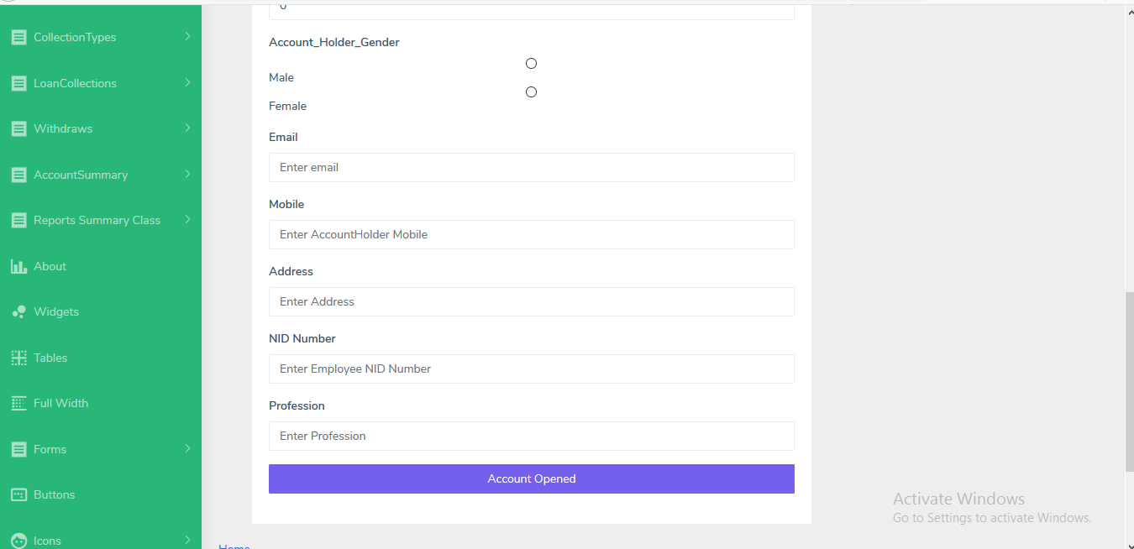
Account Add2

Slide 33
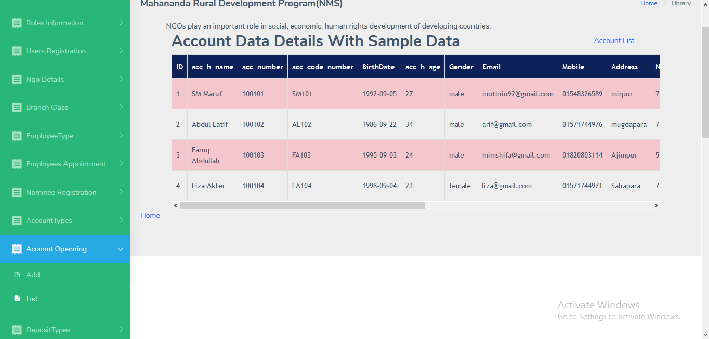
Account List

Slide 34
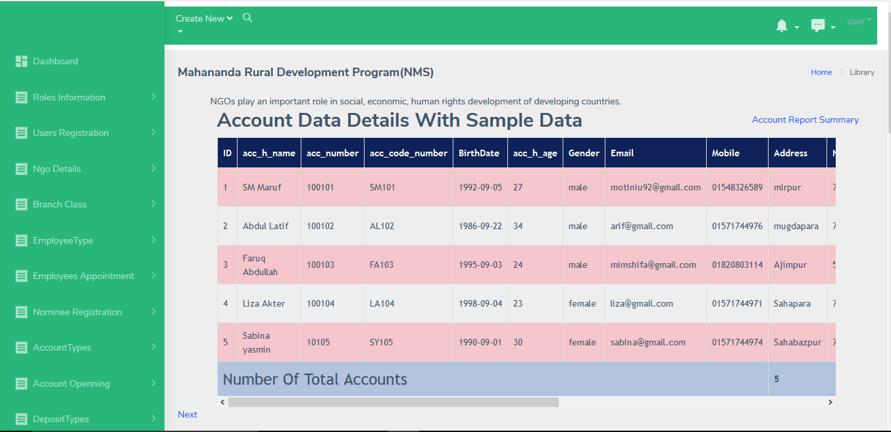
Report Summary Account

Slide 35
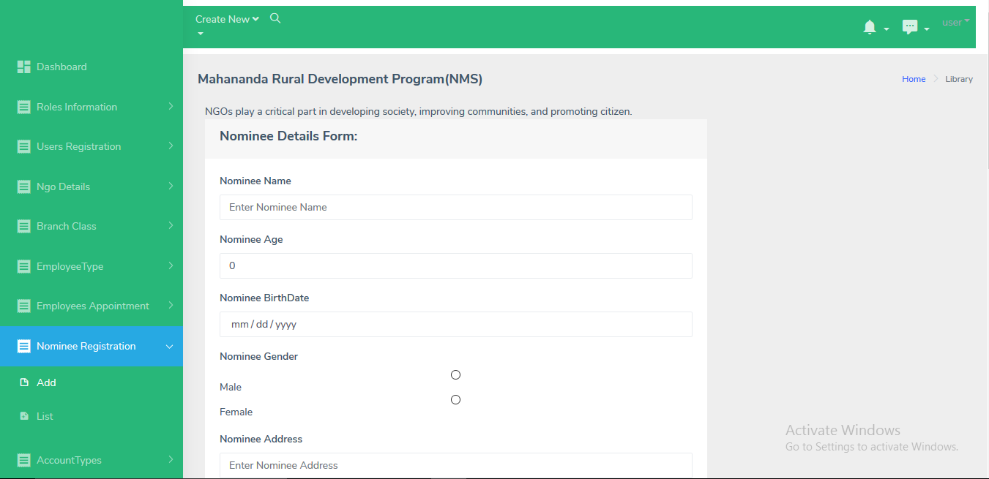
Nominee Add

Slide 36
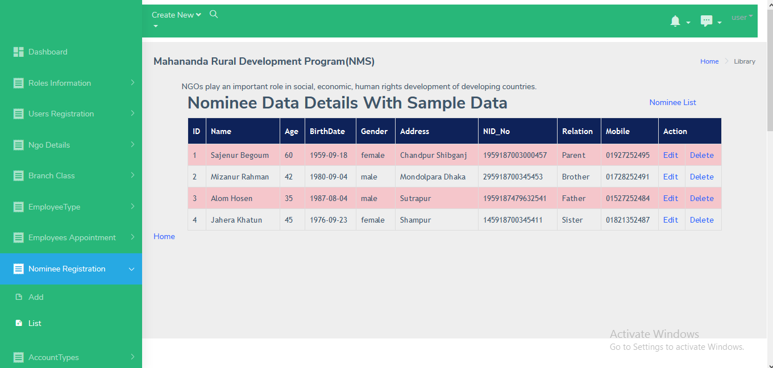
Nominee List

Slide 37
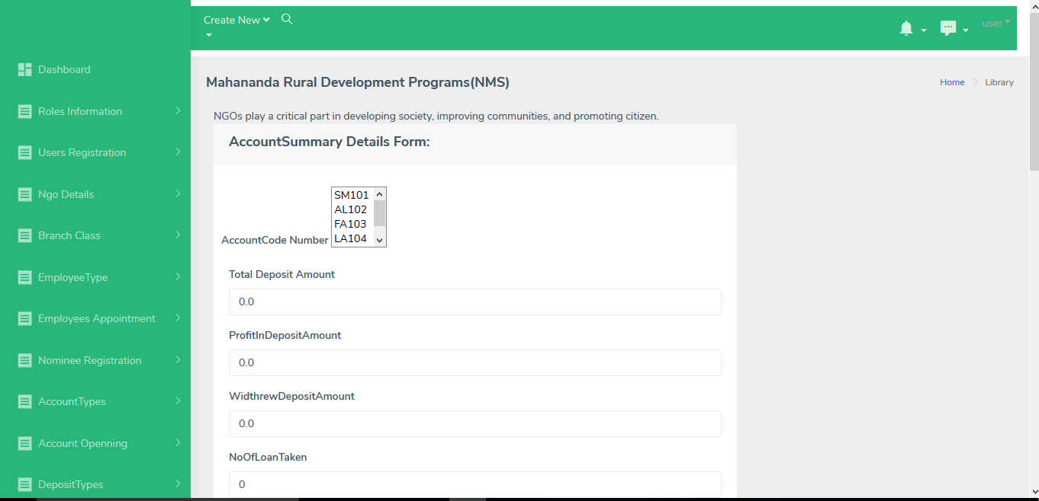
Account Summary Add

Slide 38
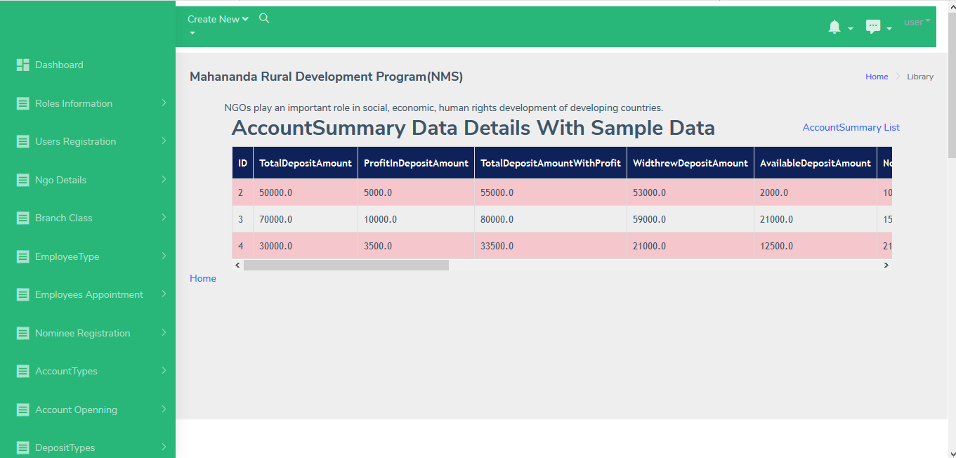
Account Summary List

Slide 39
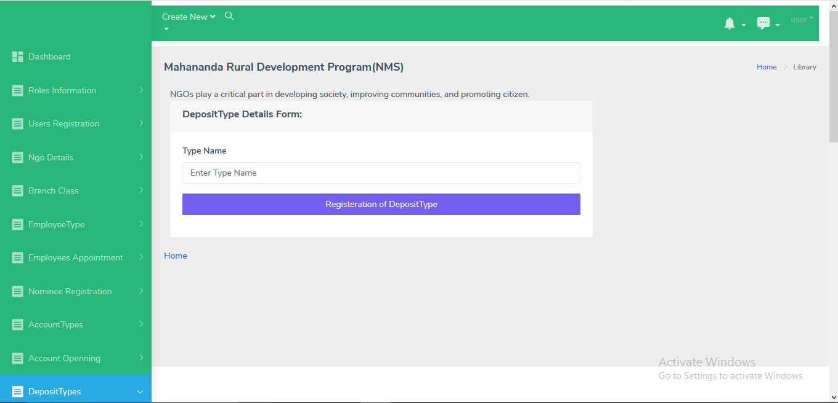
Deposit Type Add

Slide 40
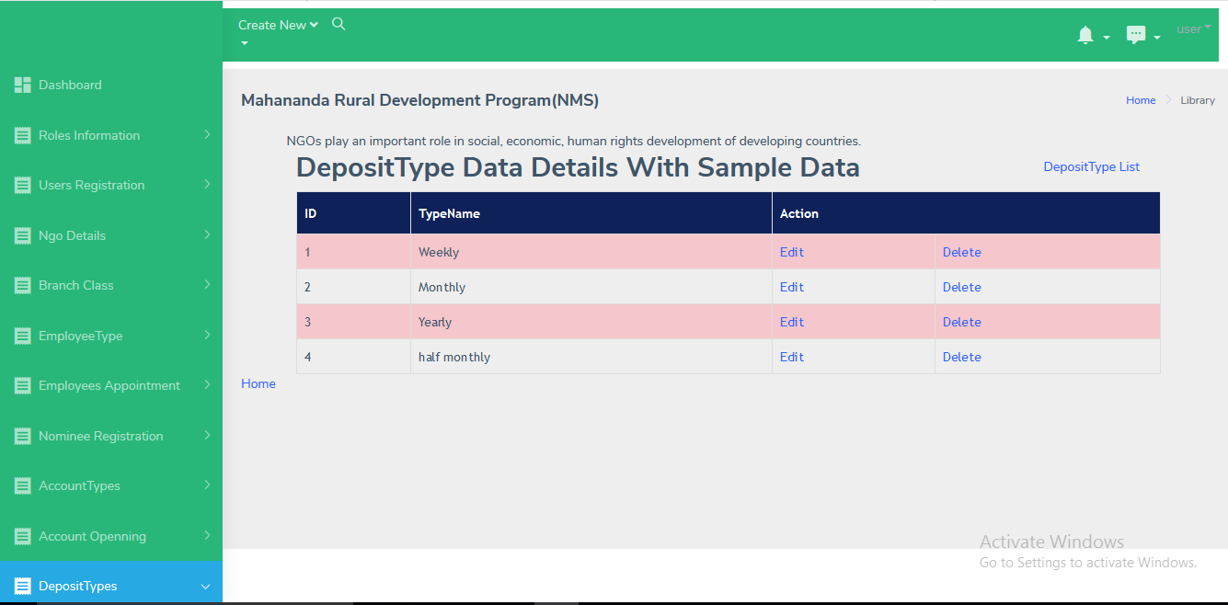
Deposit Type List

Slide 41
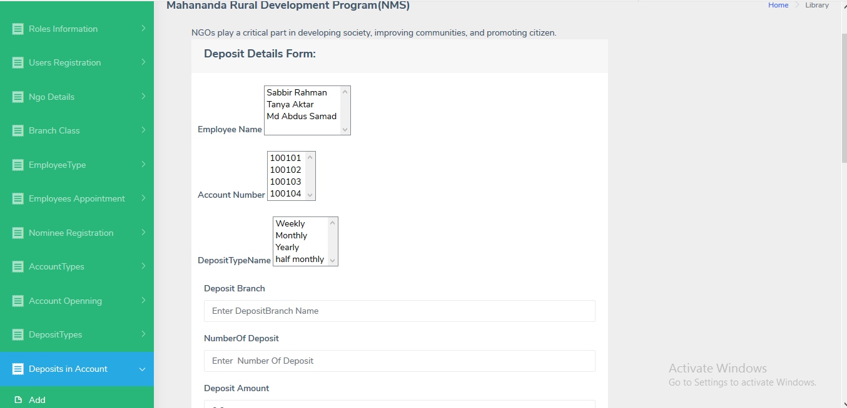
Deposit Add

Slide 42
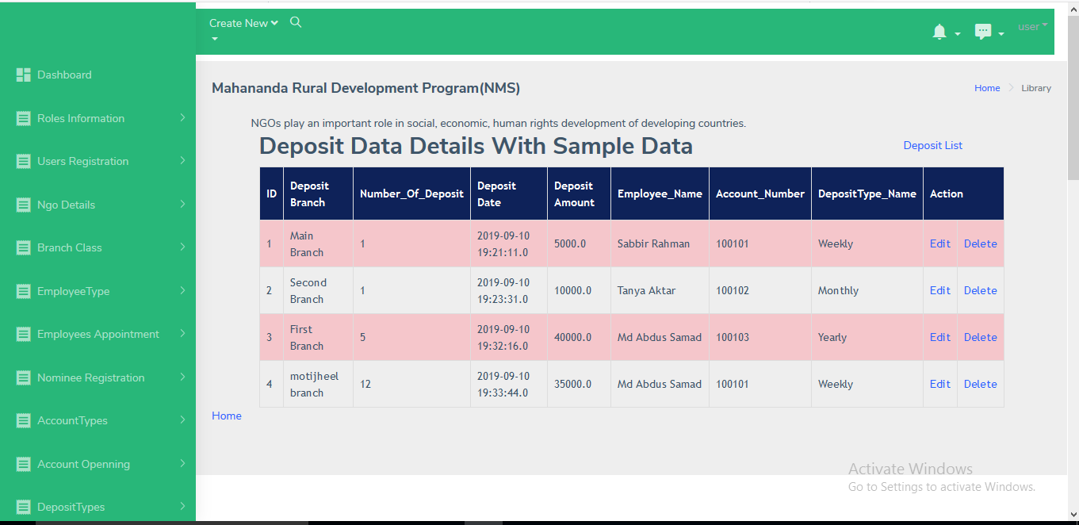
Deposit List

Slide 43
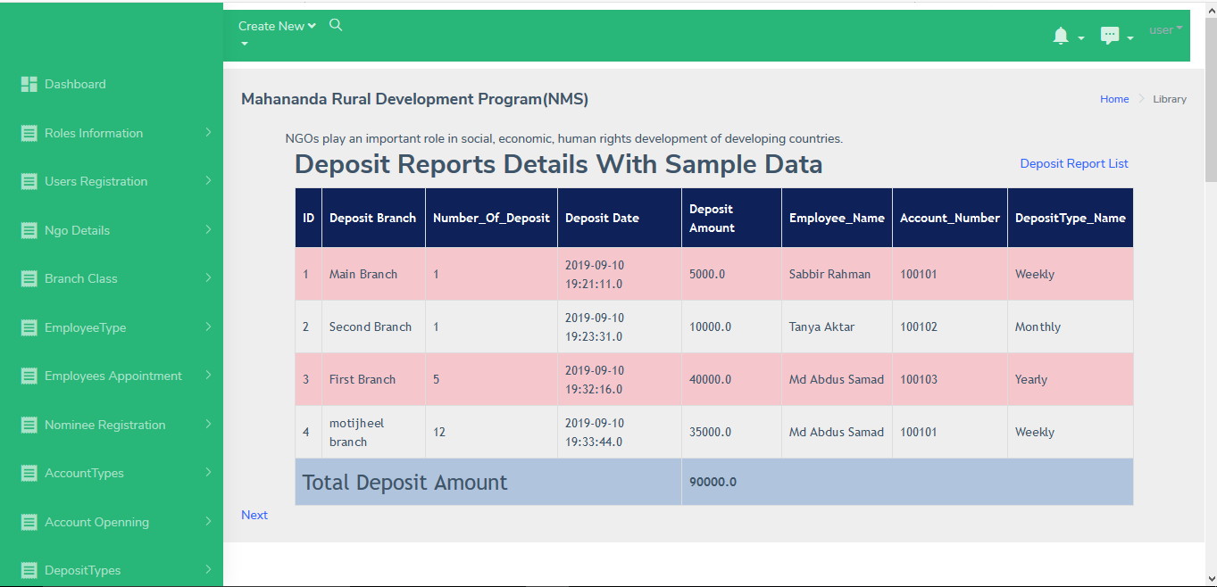
Report Summary Deposit

Slide 44
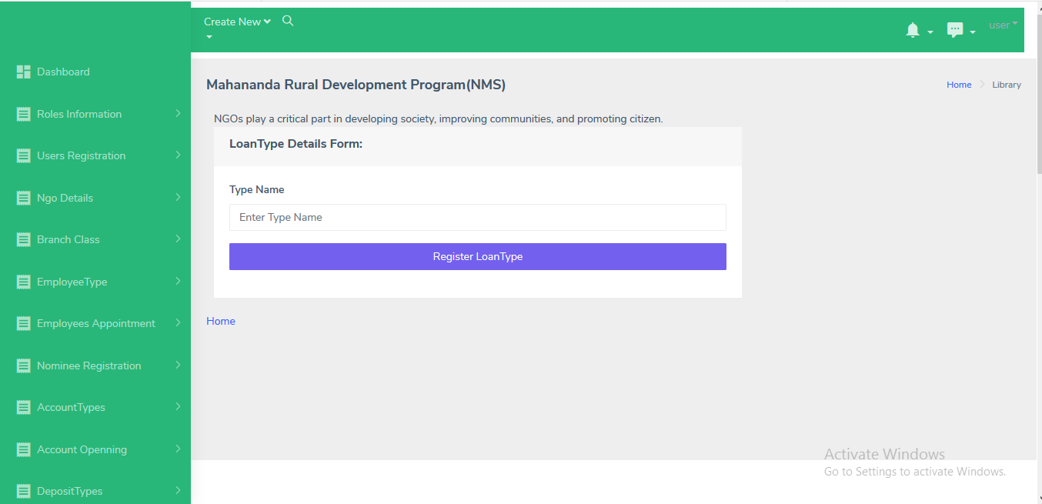
Loan Type Add

Slide 45
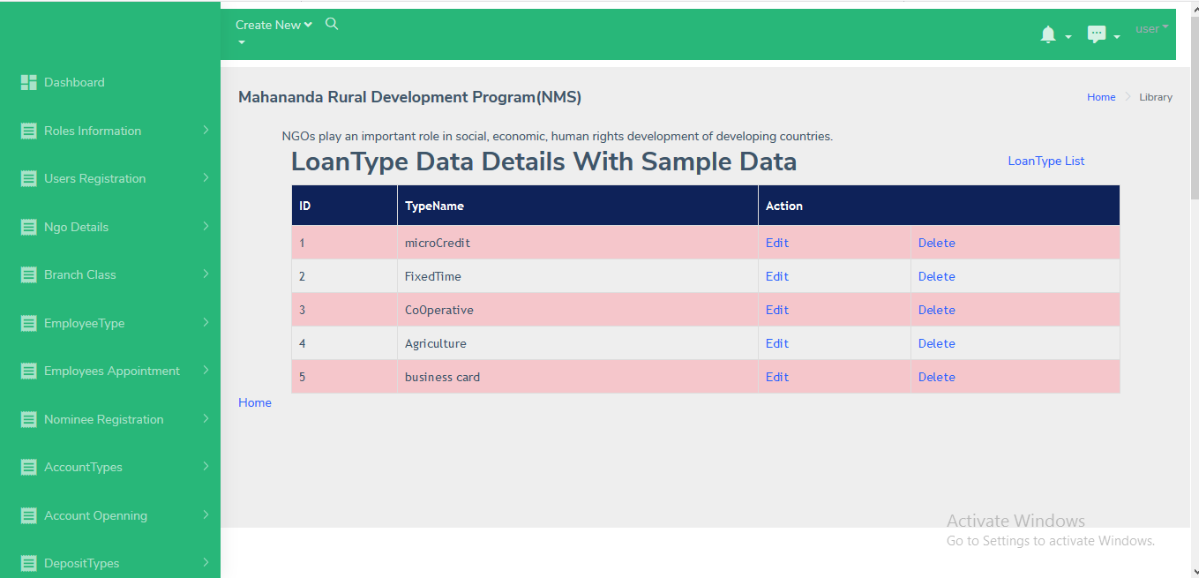
Loan Type List

Slide 46
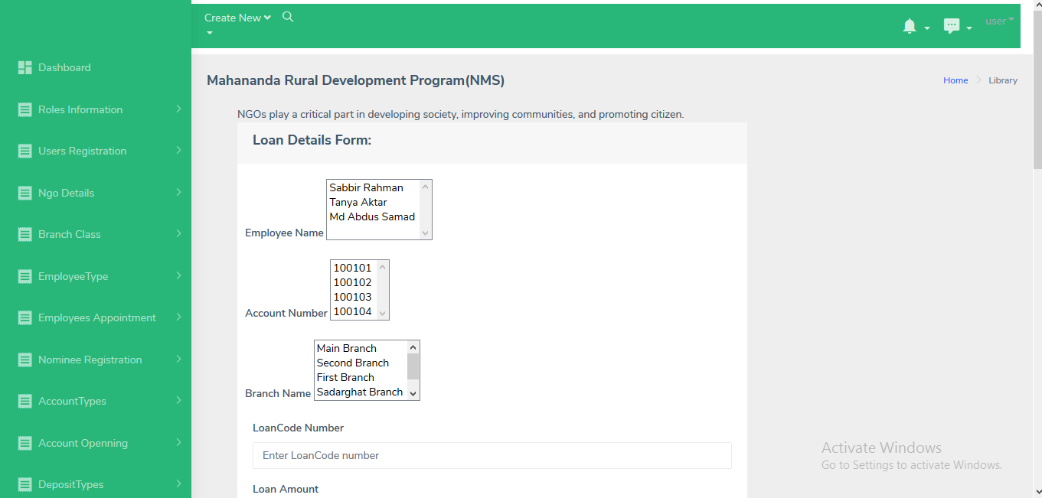
Loan Add

Slide 47
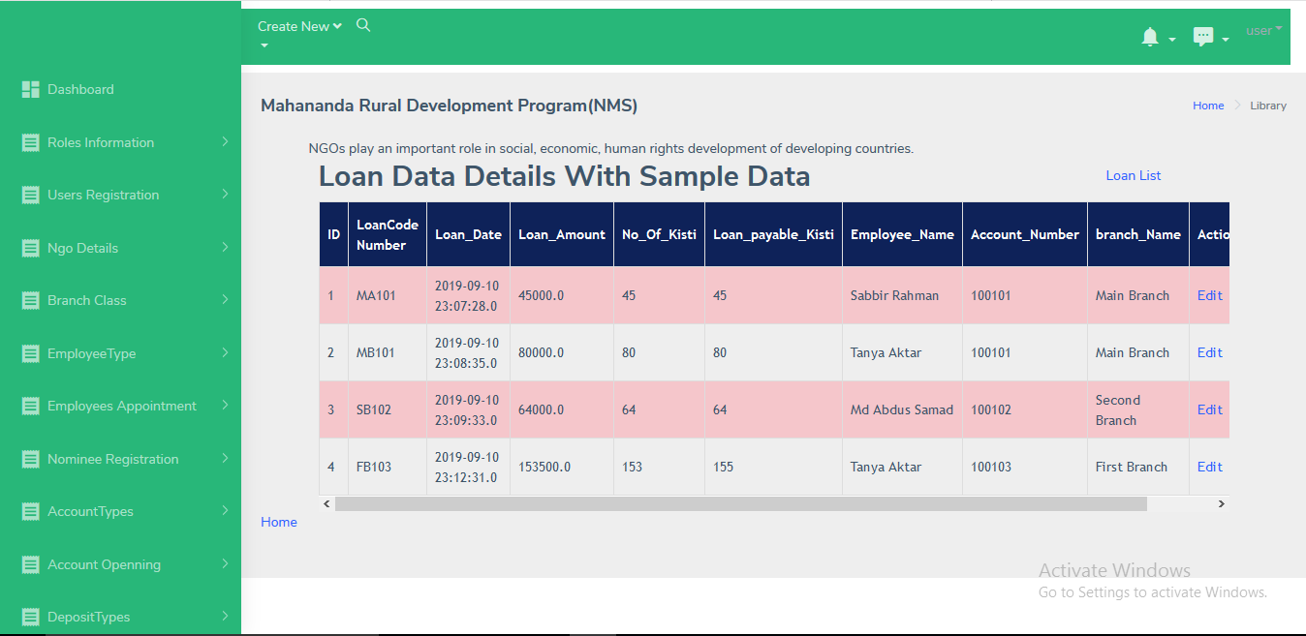
Loan List

Slide 48
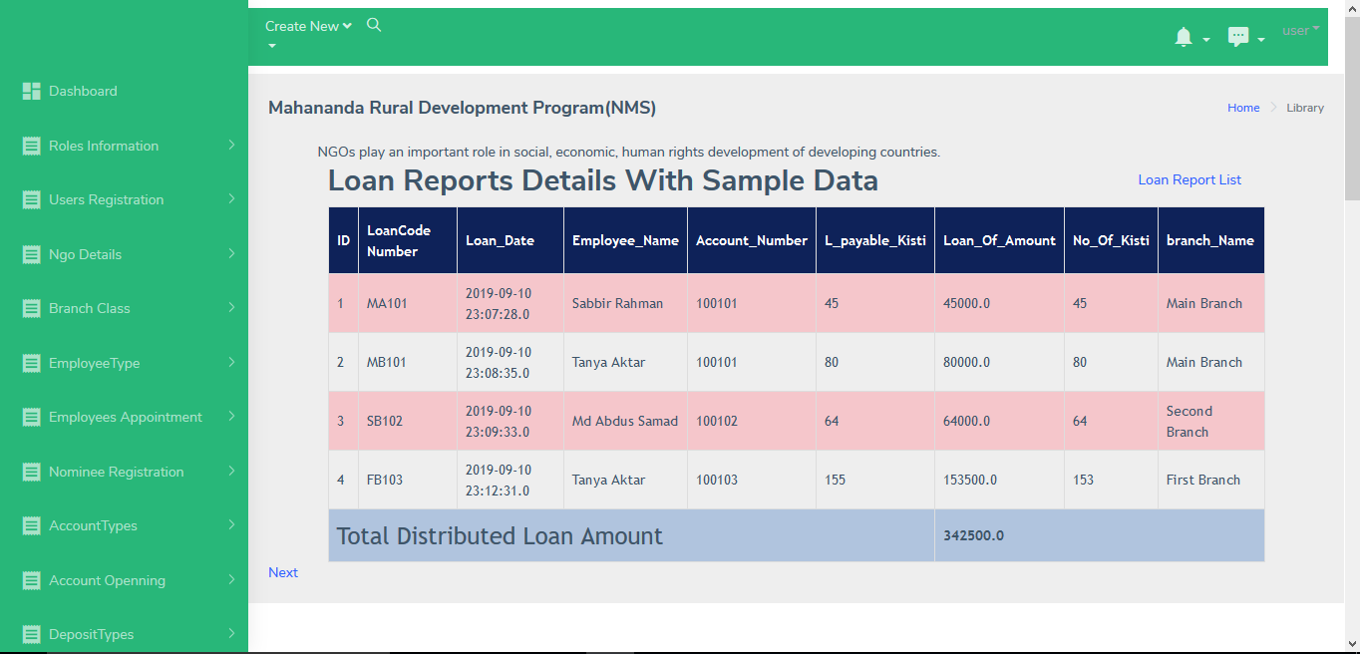
Report Summary Loan

Slide 49
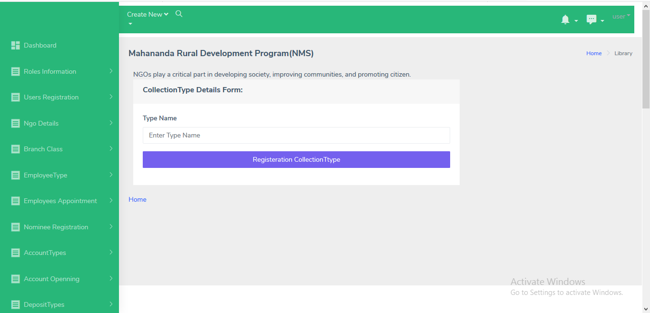
Collection Type Add

Slide 50
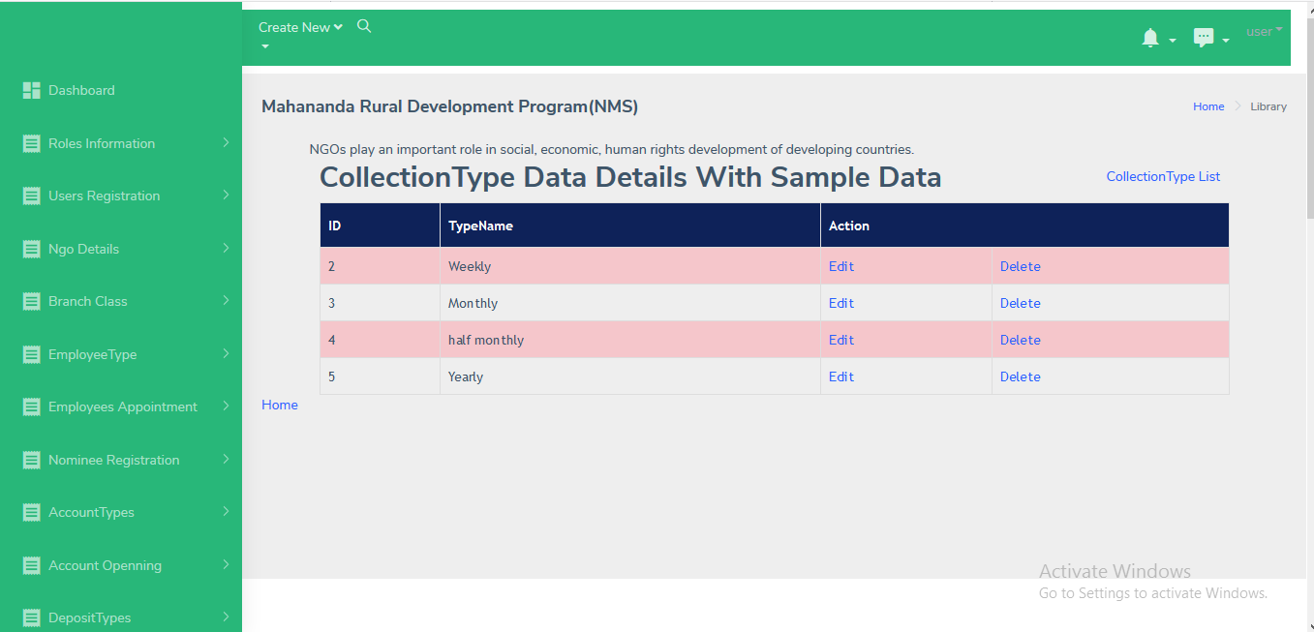
Collection Type List

Slide 51
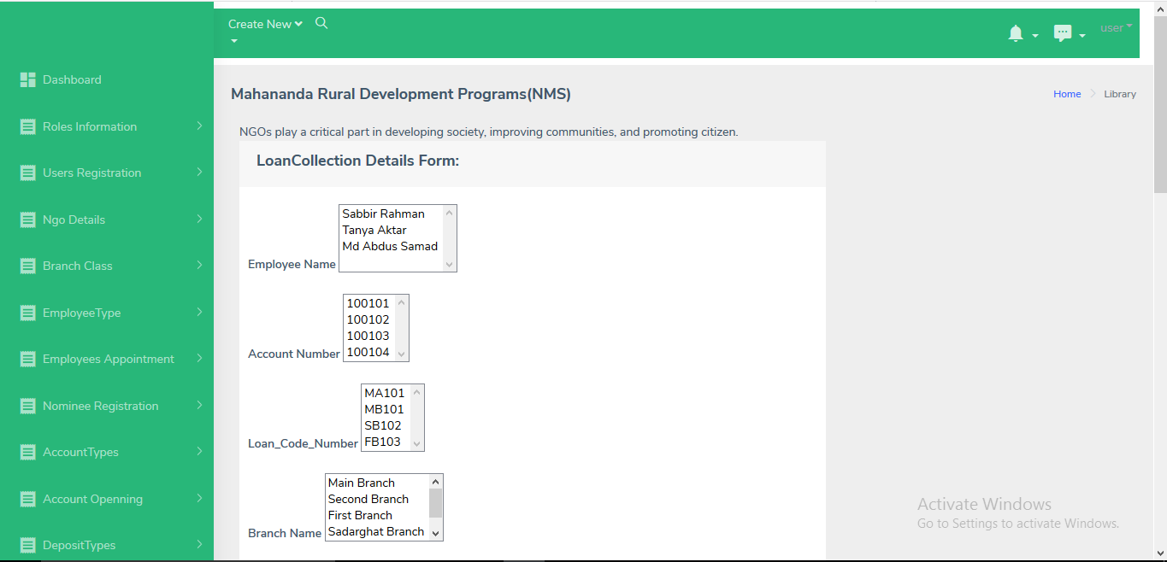
Loan Collection Add

Slide 52
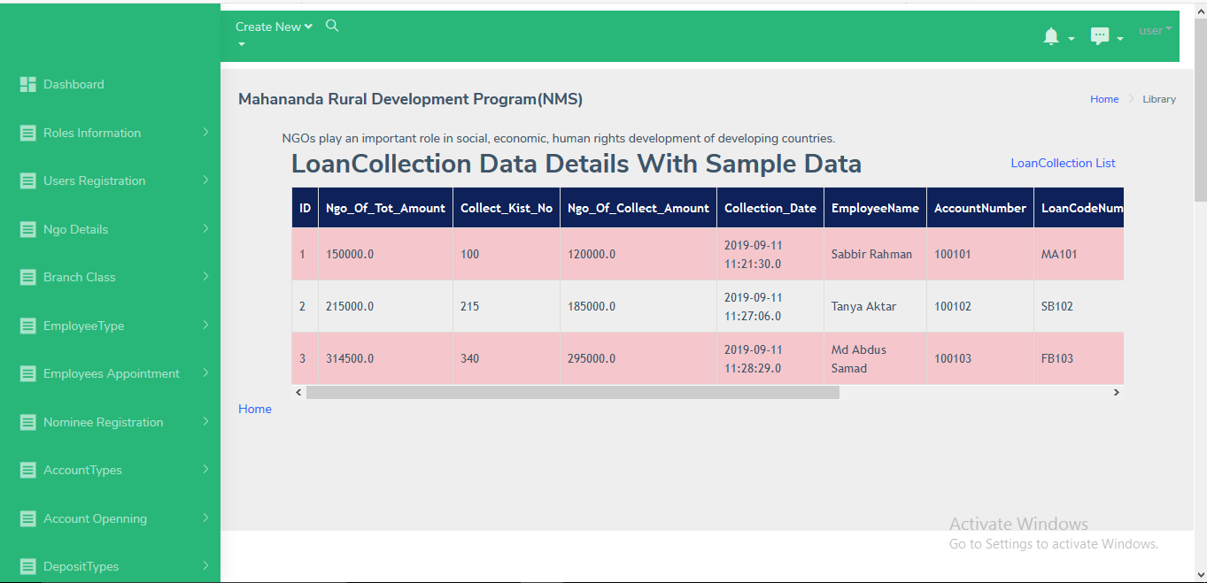
Loan Collection List

Slide 53
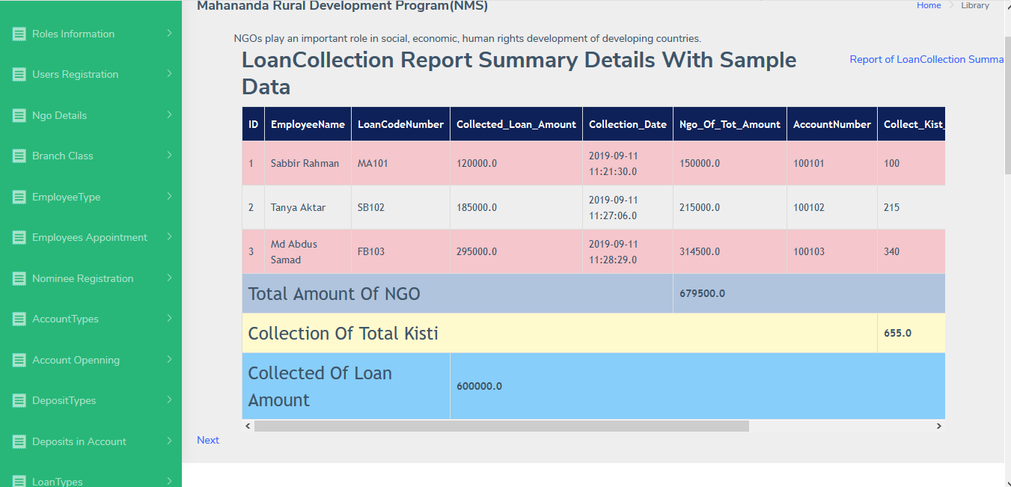
Report Summary LoanCollection

Slide 54
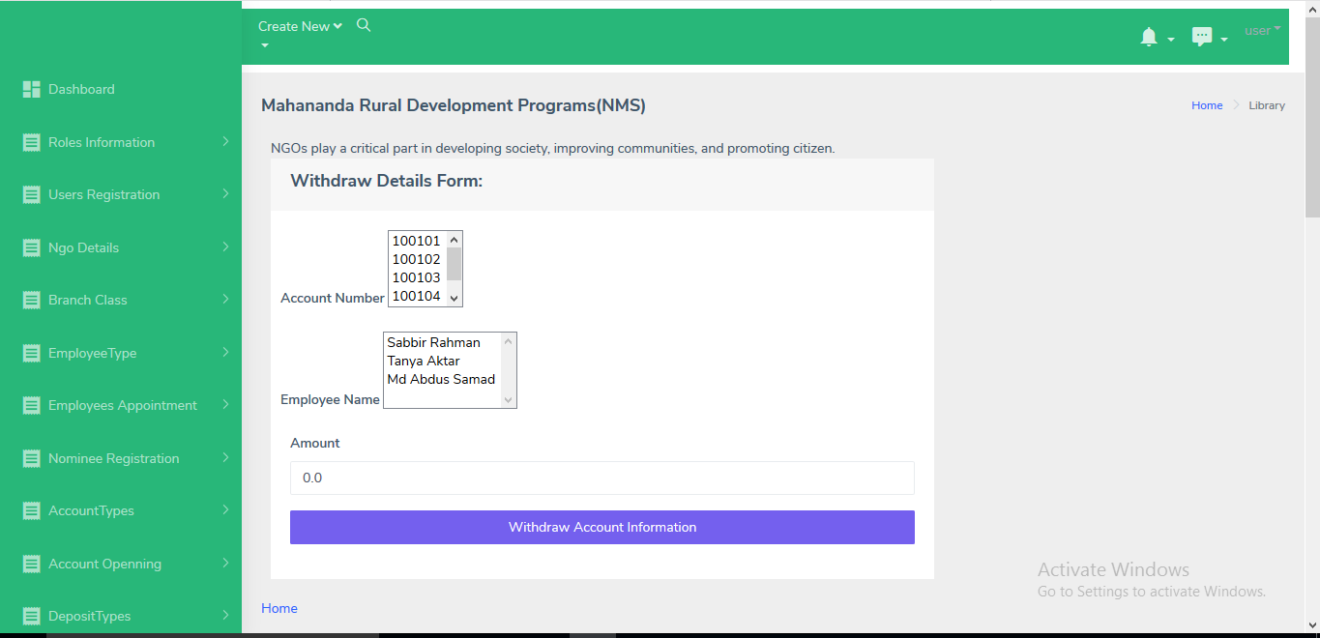
Withdraw Add

Slide 55

Withdraw List

Slide 56

Report Summary Withdraw

Slide 57

Admin profile

Slide 58

About

Slide 59
Thank You

